Slide 1
NCHRP Project 23-15, “Guidance on Risks Related to Emerging and Disruptive Transportation Technologies”
Project Final Briefing
August 2023

Slide 2
Objectives of this research as stated in RFP:
“Develop a register of risks to state and local transportation agencies and their constituents posed by emerging technologies of CAVs, electric vehicles, MoD/MaaS and Advanced Air Mobility”
“Recommend approaches agencies can use to prioritize those risks.”
“Identify policies and actions to address the risks along with the potential impacts of those policies and actions.”

Slide 3
S I X M A I N P R O J E C T T A S K S
Months: 1-7
Months: 3-8
Months: 6-11
Months: 11-16
Months: 13-18
Months: 18-21

Slide 4
Analyzing Risk in General

Slide 5
Risk registers are based on experience and best practice
In our work, we list sources of risk (“hazards”) here because for any one hazard “H”…
Risk_{H} = Likelihood_{H} x Exposure_{H} x Vulnerability_{H} x Loss value
In the report, we simplify to:
= Likelihood_{H} x “Consequence_{H}”
ID | Risk | Category | Owner | Likelihood | Impact | Mitigation
1 | Lack of buy-in by end-users | Project Management | Mariah Carey | 3 | 4 | Invite representative of each end-user group to attend requirement gathering workshops
2 | Poor attendance of training sessions | Project Management | Oprah Winfrey | 2 | 3 | Work with the Comms department to emphasize the importance of training
3 | Insufficient funds for the next stage of the project | Resources | Mariah Carey | 2 | 4 | Prepare a business case with the Sponsor to be presented at the next Finance Committee meeting so that funds can be secured for the project
Source: Risk Register Examples - Risk Management Process Steps | Project Management Templates (techno-pm.com)

Slide 6
Traditional risk register does not fit well with
the project’s larger objectives
Agency risk from emerging, disruptive transportation technology presents substantial problems with:
Uncertainty over emerging technology
Likelihood that is difficult to project with fidelity
Consequences in complex adaptive systems are difficult to foresee accurately
Heterogeneity in both agency local conditions and across agency goals
Therefore, we took an approach designed to enhance agency resilience and support them in making policies and actions robust to risk

Slide 7
Some observations that informed the NCHRP Project 23-15 report development
A technology is a risk* when it could negatively affect an agency’s ability to meet its goals under its business-as-usual strategy
Agencies could take actions to minimize those negative impacts.
But, emerging technology is almost by definition uncertain. So, it is difficult to predict the effects of either the emerging tech or the agency actions.
Therefore, agencies need approaches to manage uncertainty
Importantly, they can prioritize risks based on their potential consequences and prioritize strategies by their ability to mitigate that impact
*or opportunity, just invert the text

Slide 8
The risk management framework in the report reflects fundamental project objectives
Principal guidance is for agencies to prepare for prevalence of risk:
Enhance ability to recognize and operate under uncertainty associated with emerging technologies
Support shift toward dynamic approach to risk management
Provide a language and framing to ease early sharing of experience with emerging technology applications across agencies
Enable whole-of-agency approach to deliberating risk management
planning, operations, policy, modeling and analytics

Slide 9
Novel elements added to traditional risk register/matrix
Not intended as static data compilation; rather a framework for tailoring, adaptation, and review by individual transportation agencies
Designed to be dynamic, changeable, and tailored to local circumstances, priorities, and updates of information
Explicit discussion of who has the lead on appropriate mitigating actions
Builds in decision making under deep uncertainty (DMDU) concepts and methods
Signposts are tailored early-warning indicators of the direction, rapidity, and forms of change
Instead of likelihoods, two different measures for “level of concern” (LOC)
Characteristics-based LOC measure: used prior to implementation to assess priority
Signpost indicator LOC measure: based on observed data during implementation

Slide 10
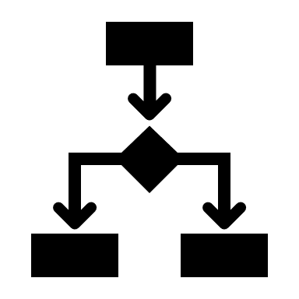
Risk Priority Process

Slide 11
Risk priority is derived from likelihood and consequences
ID | Risk | Category | Owner | Likelihood | Impact | Mitigation
1 | Lack of buy-in by end-users | Project Management | Mariah Carey | 3 | 4 | Invite representative of each end-user group to attend requirement gathering workshops
2 | Poor attendance of training sessions | Project Management | Oprah Winfrey | 2 | 3 | Work with the Comms department to emphasize the importance of training
3 | Insufficient funds for the next stage of the project | Resources | Mariah Carey | 2 | 4 | Prepare a business case with the Sponsor to be presented at the next Finance Committee meeting so that funds can be secured for the project
High | Medium | High | High
Medium | Low | Medium | High
Low | Low | Low | Medium
 | Low | Medium | High
Consequence
Likelihood

Slide 12
Step 2:
Define the likelihood of potential hazards resulting from emerging modes and technologies
Risk source
[hazard]
Step 1:
Identify the consequence – effect on agency goals
Step 3:
Assess risk priority

Slide 13
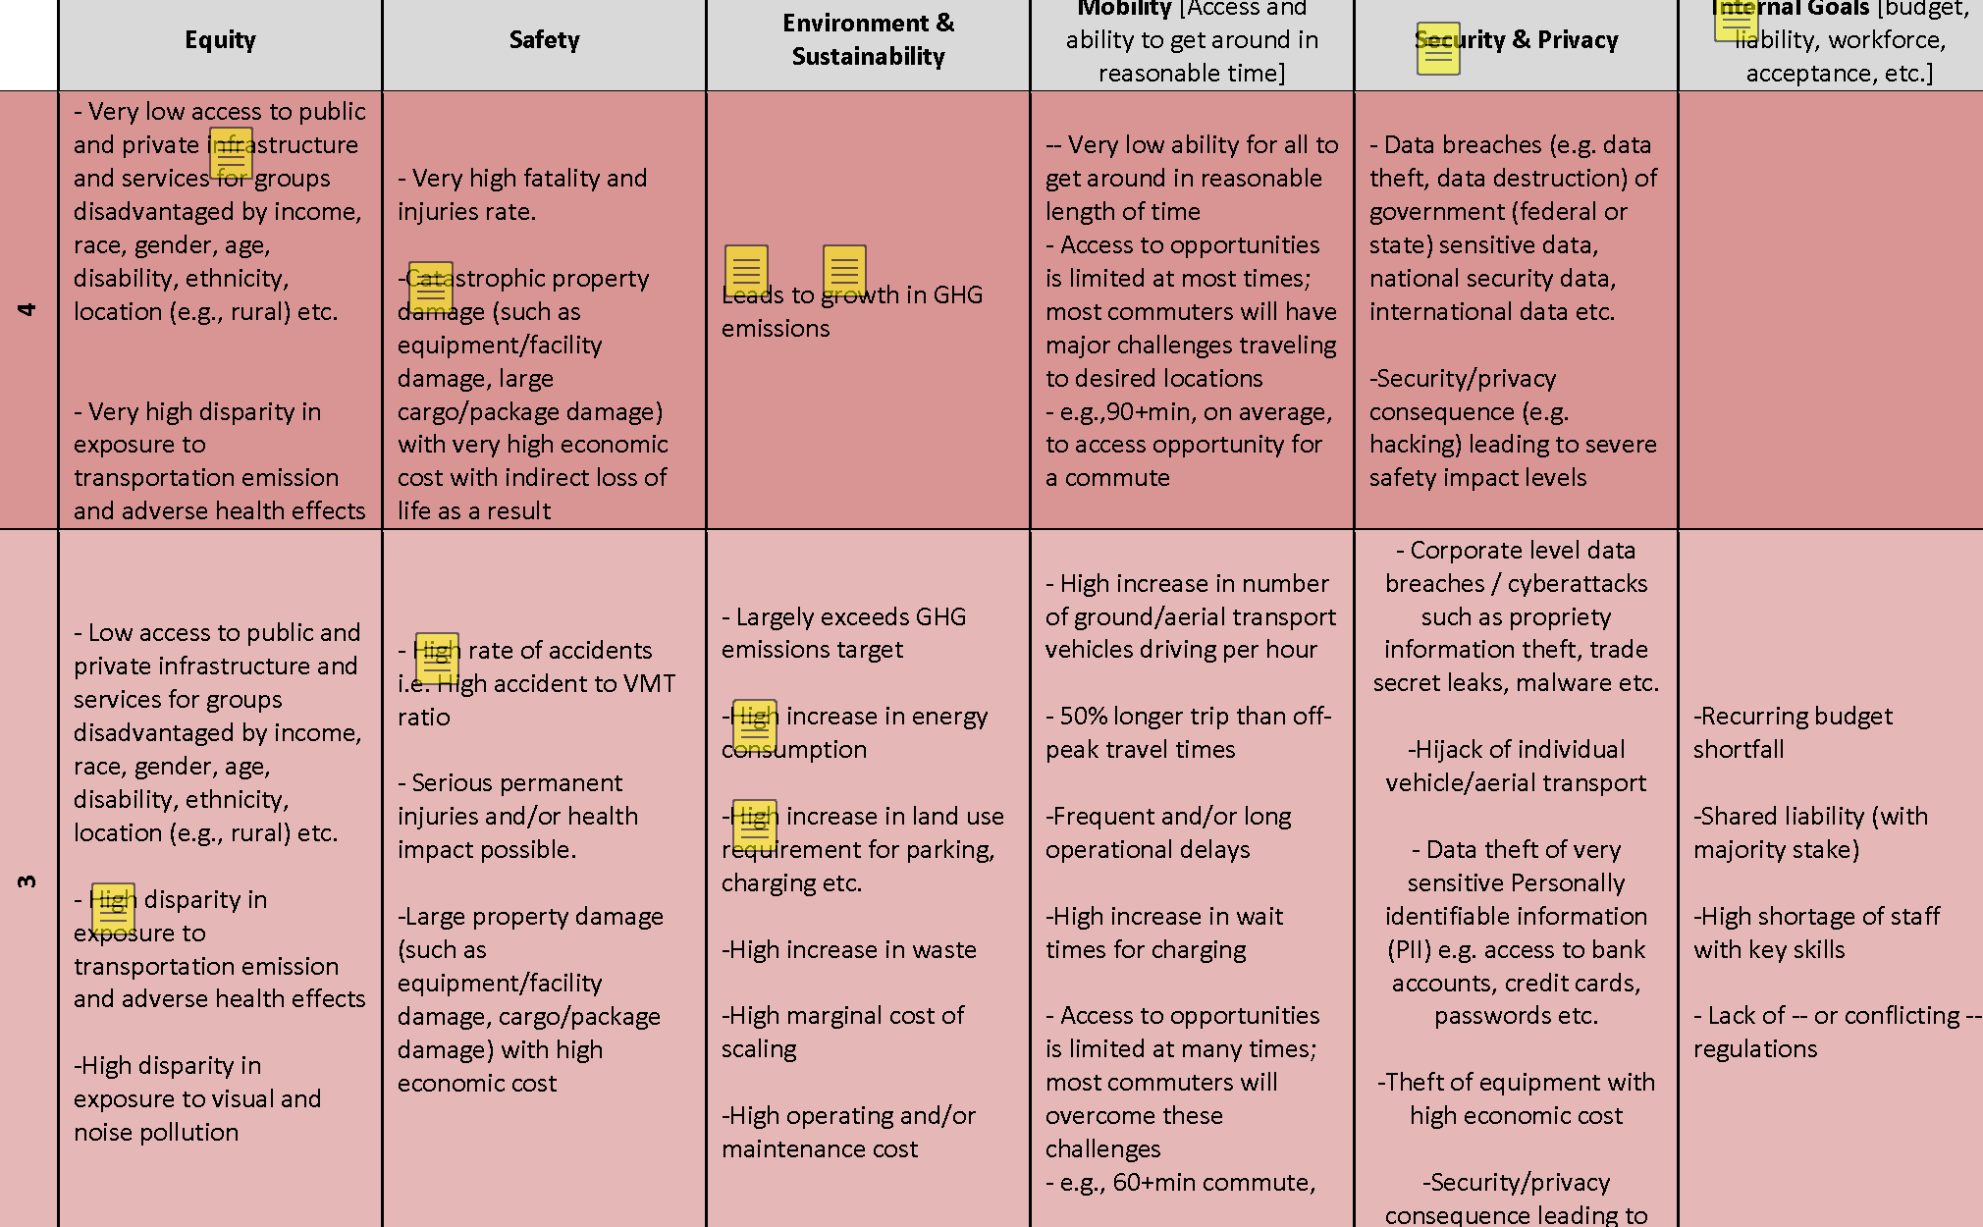
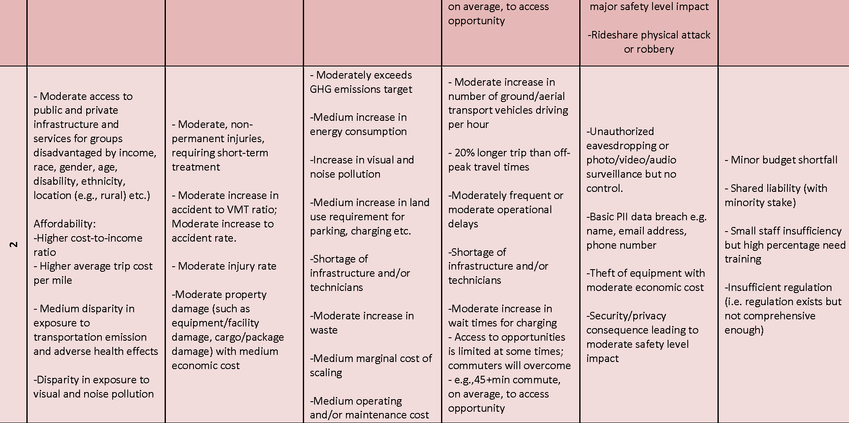
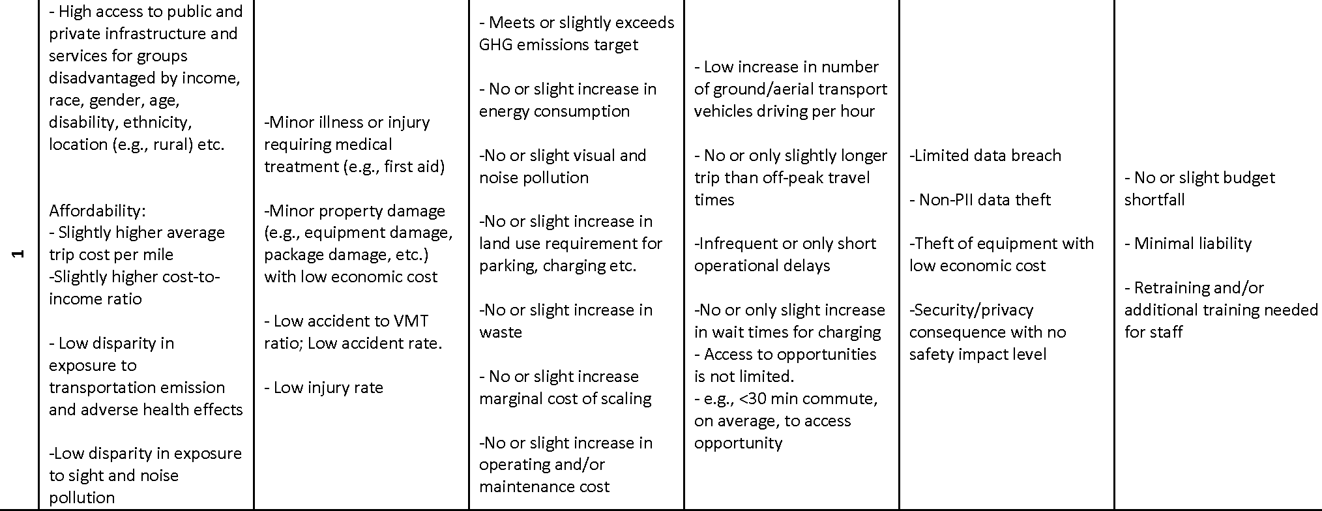
Consequence
Agency goal exposed to risk
Equity
Security & privacy
Safety
Sustainability
Mobility
Internal goals
Consequence severity rating
Risk sources (hazards) derive from literature review and Spring 2022 peer exchanges
Agency goals: selected after literature review and in consultation with NCHRP study panel
Internal goals: workforce, financial stability, liability, etc.
Use table to rate differing levels of severity for hazard/goal/technology combinations
Scale: 1 = low consequence; 4 = most severe impact
“4” is reserved for widespread injury, death, severe economic impact, or major grievous inequity
opportunity cost of non-implementation can also be fit in
Rating table designed to be suggestive, not comprehensive
Should be tailored to local circumstances, goal priorities

Slide 14
‘Likelihood’
We mostly lack information to calculate likelihood
Especially for prospective technology applications!
“Likelihood” conveys a level of concern
Use two level of concern measures as likelihood proxies:
choice of which depends on available information
may be selected and tailored to local circumstances
*’LOC’=Level of concern
Signpost Data Available?
‘Characteristics-based’ LOC* measure
Assess data availability, local circumstances
No
Novelty
Velocity
Size
Information
Response
Yes
‘Signpost indicator’ LOC* measure
‘Signpost’: an indicator selected to provide early warning of a developing source of risk to an agency goal
Especially valuable for its ties to agency bottom line
If data are available, use signpost to evaluate LOC
At early stage when no data are available, evaluate LOC by looking at characteristics of technology/hazard/ goal
Based on current level of information, so annual updates advised

Slide 15
Risk source
[hazard]
*’LOC’=Level of concern
‘Likelihood’
Signpost Data Available?
Assess data availability, local circumstances
No
‘Characteristics-based’ LOC* measure
Yes
Novelty
Velocity
Size
Information
Response
Consequence
‘Signpost indicator’ LOC* measure
Agency goal exposed to risk
Equity
Safety
Sustainability
Mobility
Security & privacy
Internal goals
Risk Matrix [risk priorities] |  | Level Of Concern (LOC) Score (Likelihood Proxy)
 |  | Low -1 | Moderate- 2 | High - 3 | Greatest - 4
Severity of Consequence Score | Severe -4 | Moderate | Moderate-High | Extreme | Extreme
 | High - 3 | Moderate | Moderate-High | High | Extreme
 | Moderate -2 | Low | Moderate | Moderate-High | Moderate-High
 | Low -1 | Low | Low | Moderate | Moderate
Consequence severity rating

Slide 16
Selected Findings

Slide 17
‘Likelihood’
*’LOC’=Level of concern
Hazard (C6): CAVs increase private vehicle ownership
Signpost Data Available?
Projected CAV rollout modality and trends in car ownership.
‘Characteristics-based’ LOC* measure
No
Novelty
Velocity
Size
Information
Response
Yes
Consequence
Agency goal exposed to risk
Signpost Indicator LOC Measure:
Projected CAV rollout modality (% Shared CAVs: e.g., 1-2% of total fleet by 2030)
Signpost Indicator State: On target, Trend = Negative, Tolerance level (+/-): Uncertain
Equity
Safety
Sustainability
Mobility
Security & privacy
Internal goals
Risk Matrix [risk priorities] |  | Level Of Concern (LOC) Score (Likelihood Proxy)
 |  | Low -1 | Moderate- 2 | High - 3 | Greatest - 4
Severity of Conse-quence Score | Severe -4 | Moderate | Moderate-High | Extreme | Extreme
 | High - 3 | Moderate | Moderate-High | High | Extreme
 | Moderate -2 | Low | Moderate | Moderate-High | Moderate-High
 | Low -1 | Low | Low | Moderate | Moderate
Consequence severity rating

Slide 18
‘Likelihood’
*’LOC’=Level of concern
Hazard (C1): CAVs increase private vehicle ownership
Signpost Data Available?
Projected CAV rollout modality and trends in car ownership.
‘Characteristics-based’ LOC* measure
No
Novelty
Velocity
Size
Information
Response
Yes
Consequence
Agency goal exposed to risk
Signpost Indicator LOC Measure:
Projected CAV rollout modality (% Shared CAVs: e.g., 1-2% of total fleet by 2030)
Signpost Indicator State: On target, Trend = Negative, Tolerance level (+/-): Uncertain
Equity
Safety
Sustainability
Mobility
Security & privacy
Internal goals
Risk Matrix [risk priorities] |  | Level Of Concern (LOC) Score (Likelihood Proxy)
 |  | Low -1 | Moderate- 2 | High - 3 | Greatest - 4
Severity of Conse-quence Score | Severe -4 | Moderate | Moderate-High | Extreme | Extreme
 | High - 3 | Moderate | Moderate-High | High | Extreme
 | Moderate -2 | Low | Moderate | Moderate-High | Moderate-High
 | Low -1 | Low | Low | Moderate | Moderate
Consequence severity rating

Slide 19
Signpost indicator-based LOC measure compares current state versus trends over time
This scaling privileges trends (rows) over current status (columns)
Errs on the side of encouraging early attention and caution
 |  | State of Signpost Indicator
 |  | On Target or within Tolerance | Out of Tolerance | Substantially Out of Tolerance
Trend in Signpost Indicator | Indiscernible | Moderate-2 | High-3 | Greatest-4
 | Strongly Negative | High-3 | Greatest-4 | Greatest-4
 | Mildly Negative | Moderate-2 | High-3 | High-3
 | Positive | Low-1 | Moderate-2 | Moderate-2

Slide 20
Characteristics-based LOC balances categories of current knowledge with simple set of decision criteria
If “Response” and “Velocity” are both 3 or 4, the CB-LOC measure should be set at an overall value of 4;
If “Response” alone is a 3 or 4, the CB-LOC measure should be set at an overall value of 3;
If “Response” is rated 1, the CB-LOC measure should be set at an overall value of 1;
In all other cases, take the simple average across the five elements of the measure and round down to the nearest whole number but no less than 1.
DIMENSION | SCALE | QUALITATIVE ASSESSMENT GUIDELINE
Novelty | 4 | Many innovative elements embodied in a pre-existing form
 | 3 | Entirely innovative technology embodied in a new form
 | 2 | Some innovative technologies embodied within existing, customary modes and processes
 | 1 | Few novel elements involved
Velocity | 4 | Adoption rate is high; potential market is large
 | 3 | Adoption rate is high, potential market may be small
 | 2 | Adoption rate is low, potential market may be large
 | 1 | Adoption rate is low, potential market is small
Size (affected) | 4 | Direct and indirect effects from hazard could affect total group
 | 3 | Direct and indirect effects from hazard could affect sizable group
 | 2 | Direct and indirect effects from hazard could affect small group
 | 1 | Little or no effect to be expected beyond a narrow minimum
Information | 4 | Little or no information available
 | 3 | Information gathering requires outreach to other agencies and early adopters
 | 2 | Information available on selected basis in published literature or on-line sources
 | 1 | Little or no concern about access to useful and timely information
Response | 4 | Mitigating consequence may be so challenging that adaptation is required
 | 3 | Mitigation requires acquiring new capability, resources, or external partnership
 | 2 | Mitigation requires developing mitigation response to address
 | 1 | Little or no concern about ability to mitigate or minimize in a timely manner -or- N/A

Slide 21
Consequence and severity rating appear in risk register…
Risk Source by Tech Group | Potential Sources of Risk |  |  | Consequences for Transportation Agency Goals |  |  | Transportation Agency Policies and Actions |  | Risk Priority
 | Risk source [Hazard] | Signpost Indicators to Watch | Likelihood Proxy | Goal affected | Potential Consequences | Severity Score | Potential Mitigating Actions | Action owners | Priority Score
C2: Hacked Vehicle | CAVs are successfully hacked | Projected vulnerabilities of CAV technologies (e.g., vehicle sensors, internet-connected / edge devices). | Great-4 | Security & Privacy | In addition to allowing the attacker to access personally identifiable information (PII) and use it for financial benefit (for example, to redirect payments from charging or carry out Denial of Service attacks via CAV charging communication channels) (Hodge et al., 2019) | High-3 | 1. Increasing Cybersecurity Awareness. 2. Protecting the boundary between CAVs and transportation infrastructure | Federal / State / Local DOTs, MPOs | Extreme
E5: Fuel Tax Revenue Decline | Declining in fuel tax revenue from increasing EV adoption rates | 1. EV registration rates 2. Highway Trust Fund minimum prudent amount | High-3 | Internal Goal | Expecting over $1B revenue lost annually by 2030 | High-3 | Design alternative tax schemes for EV while considering consistency with neighboring states and equity | State and Federal DOTs, MPOs; State and Federal Legislatures | High

Slide 22
…As do ‘signpost’ indicators and selected likelihood proxy
Risk Source by Tech Group | Potential Sources of Risk |  |  | Consequences for Transportation Agency Goals |  |  | Transportation Agency Policies and Actions |  | Risk Priority
 | Risk source [Hazard] | Signpost Indicators to Watch | Likelihood Proxy | Goal affected | Potential Consequences | Severity Score | Potential Mitigating Actions | Action owners | Priority Score
M2: Road Crashes | Road Crashes | 1. Crash data 2. Fatal Crash data | High-3 | Safety | Increased transportation crashes (and associated injuries/deaths) | Moderate-2 | Geofencing for high-conflict locations to slow or stop usage. Design and speed limit policy (20 is plenty) | State DOTs and MPOs work with local governments on policy and mitigation | Mode-rate-High
A2: Disparate Social and Environmental Impacts | Vulnerable populations bear a disproportion-ate burden of AAM impacts. | Demographics of people impacted by AAM operations (e.g., flights and vertiports/take-off and landing infrastructure) | High-3 | Equity | Low-income households, minority communities, and other vulnerable or historically underserved populations bear disproportionate adverse effects of AAM operations (e.g., noise, visual pollution, etc.) | Severe-4 | 1) Leverage community engagement and engage communities and underrepresented populations early and often 2) Incorporate environmental justice and disparate impact analysis as part of vertiport and airspace planning; consider conducting an analysis at regular intervals after implementing AAM service to determine if changes are needed (e.g., routing) 3) Consider anti-displacement and gentrification policies in the vicinity of vertiports and intermodal passenger facilities with AAM | U.S. Department of Transporta-tion, Federal Aviation Administra-tion; State DOTs | Extreme

Slide 23
Supplementary information designed to provide
greater insight and serve as a template:
Signpost indicator-based LOC
 | Characteristics-based Level of Concern (Likelihood Proxy) |  |  |  |  | Character-istics Level of Concern Result | Signpost Indicator Level of Concern (Likelihood Proxy) |  |  | State of Signpost Indicator | Signpost Indicator Trend | Sign-post LOC Result | Likeli-hood Proxy
Risk Source by Tech Group | Novelty | Velocity | Size | Inform-ation | Response |  | Metric | Target | Tolerance Level (+/-)
C6 | Mod-erate-2 | High-3 | Moderate-2 | Low-1 | Moderate-2 | Moderate-2 | 1. Projected CAV rollout modality (% Shared AVs) 2. Projected Impact on car ownership (% decrease) | 1. Shared AV Fleet (% of total cars) = 1-2% by 2030s 2. Private CAVs projected to be 5% of total vehicle sales by 2030 | Uncertain | On Target | Negative | Moderate-2 | Moderate-2
C8 | Low-1 | Moderate-2 | High-3 | Low-1 | Moderate-2 | Low-1 | 1. 1.2mn chargers required for public use cases by 2030 2. Infrastructure investments and existing pilot programs, including but not limited to EV charging infrastructure (Level 2 and DC fast charging) | 1. At ~150k public use chargers at ~50k charging stations nationwide today, we need ~150k new EV chargers/year to meet targets for electrification under Federal ZEV sales target 2. Public EV Charging Stations per 100,000 households: Ratio (high-income urban districts) to (Low-to-moderate urban districts) | Conservative target (tolerance ~5%) | Out of Tolerance | Negative | High-3 | High-3

Slide 24
Supplementary information designed to provide
greater insight and serve as a template:
Characteristics-based LOC
 | Characteristics-based Level of Concern (Likelihood Proxy) |  |  |  |  | Character-istics Level of Concern Result | Signpost Indicator Level of Concern (Likelihood Proxy) |  |  | State of Signpost Indicator | Signpost Indicator Trend | Sign-post LOC Result | Likeli-hood Proxy
Risk Source by Tech Group | Novelty | Velocity | Size | Inform-ation | Response |  | Metric | Target | Tolerance Level (+/-)
C6 | Mod-erate-2 | High-3 | Moderate-2 | Low-1 | Moderate-2 | Moderate-2 | 1. Projected CAV rollout modality (% Shared AVs) 2. Projected Impact on car ownership (% decrease) | 1. Shared AV Fleet (% of total cars) = 1-2% by 2030s 2. Private CAVs projected to be 5% of total vehicle sales by 2030 | Uncertain | On Target | Negative | Moderate-2 | Moderate-2
C8 | Low-1 | Moderate-2 | High-3 | Low-1 | Moderate-2 | Low-1 | 1. 1.2mn chargers required for public use cases by 2030 2. Infrastructure investments and existing pilot programs, including but not limited to EV charging infrastructure (Level 2 and DC fast charging) | 1. At ~150k public use chargers at ~50k charging stations nationwide today, we need ~150k new EV chargers/year to meet targets for electrification under Federal ZEV sales target 2. Public EV Charging Stations per 100,000 households: Ratio (high-income urban districts) to (Low-to-moderate urban districts) | Conservative target (tolerance ~5%) | Out of Tolerance | Negative | High-3 | High-3

Slide 25
Risk register includes 62 sources of risk (56 unique)
Agency Goal: | Safety | Equity | Internal | Mobility | Privacy and Security | Sustain-ability | Other | Total | Share %
Priority Score:
5 - Extreme | 2 | 3 | 0 | 0 | 2 | 1 | 1 | 9 | 13
4 - High | 3 | 1 | 1 | 1 | 1 | 0 | 2 | 9 | 13
3 - Moderate-high | 4 | 9 | 4 | 1 | 2 | 3 | 1 | 24 | 36
2 – Moderate | 6 | 3 | 0 | 1 | 3 | 2 | 1 | 16 | 24
1 - Low | 3 | 0 | 0 | 3 | 1 | 1 | 1 | 9 | 13
Total | 18 | 16 | 5 | 6 | 9 | 7 | 6 | 67 | 100

Slide 26
Equity issues loom as a major concern
Distribution of Risks by Agency Goals, sorted by Risk Priority Score

Slide 27
Technologies vary by sources of risk
Distribution of Risks to Agency Goals by Technology Group

Slide 28
High-level strategy and policy briefs were derived from mitigating actions in the risk register
Policy Brief | Topic
1 | Ensure access to necessary workforce skills
2 | Monitor for early signpost detection
3 | Enhance cyber security, data privacy, and awareness
4 | Ensure an adaptive safety culture to risks from emerging technologies
5 | Prepare data sharing, data management, and digital policy
6 | Detect and examine implicit assumptions to enhance awareness
7 | Create capacity for DMDU (non-predictive) analytics
8 | Strengthen sensitivity to equity implications of agency decisions
9 | Practice early stakeholder and community engagement

Slide 29
High-level policy or strategy guides largely follow the same outline
Description of the higher-level policy or strategy
How it is intended to enhance agency capabilities
How to conduct the policy or strategy, if applicable
Stakeholder considerations
Potential unintended consequences, and
Hurdles and potential obstacles to employing the policy or strategy

Slide 30
This presentation was developed by RAND Corporation and Sam Schwartz under NCHRP Project 23-15. More information about this topic can be found in NCHRP Research Report 1090: Risks Related to Emerging and Disruptive Transportation Technologies: A Guide, which is available on the National Academies Press website (https://nap.nationalacademies.org).
NCHRP is sponsored by the individual state departments of transportation of the American Association of State Highway and Transportation Officials. NCHRP is administered by the Transportation Research Board (TRB), part of the National Academies of Sciences, Engineering, and Medicine, under a cooperative agreement with the Federal Highway Administration (FHWA). Any opinions and conclusions expressed or implied in resulting research products are those of the individuals and organizations who performed the research and are not necessarily those of TRB; the National Academies of Sciences, Engineering, and Medicine; FHWA; or NCHRP sponsors.

